Slide 1
WELCOME
The Birchington Neighbourhood Plan
Update & Review
Councillor Neville Hudson, Chairman

Slide 2
Health and Safety
Covid-19 guidance
Emergency Exits

Slide 3
Presenters: Rod Giddins & Cllr Nick Blankley
  Introduction
    a. Objectives for the session
  Neighbourhood Planning - A Rapid Refresh
    What is a Neighbourhood Plan?
    Why have one?
  The Birchington Neighbourhood Plan
    The Story So Far
    Policies – two parts with questions and discussion
  What Happens Next?
    6 weeks’ consultation
    Beyond the consultation
  Closing Remarks
The Programme

Slide 4
FROM US:
A progress report on development of the Birchington Neighbourhood Plan
An update on the thinking and contents of the draft Plan
A better understanding of the next stages and what you will be asked to do
FROM YOU:
Questions that you may have about the process and the Plan itself
Comments and suggestions that might help us to improve what we have done so far and what we’re planning to do
Objectives
4

Slide 5
What is a Neighbourhood Plan?
  Sets out planning policies for the management of development, including changes to existing buildings and structures
  Part of the statutory local development plan for the area
  Used when considering planning applications in Birchington
Why have one?
  To provide policies to manage change in the future, whilst
  conserving and enhancing the character of Birchington
  protecting our natural environment, green spaces, coast and community facilities
  supporting local businesses
A Rapid Refresh

Slide 6
December 2016
Parish council requests permission to establish a neighbourhood plan area.
March 2017
Neighbourhood Plan Forum established with council and community representation.
May 2017
Neighbourhood plan area approved by Thanet district Council
The Story So Far
June 2019
Community Design Day – all day event involving over 150 people.
October 2019
First version of the plan produced.
March 2020
Independent professional review of version 5A of the plan.
September 2020
Specialist consultants appointed to provide expert advice and guidance.
August / September 2021
Version 8 of the plan produced for community consultation.

Slide 7
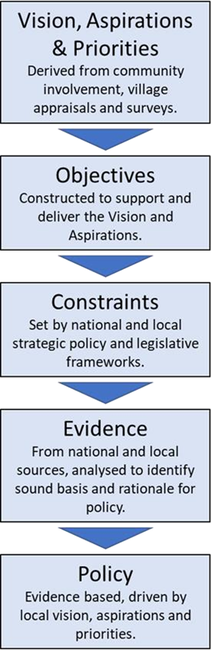
Birchington to be a place where:
health and wellbeing for all is the top priority.
our connections to the seas, skies and land are cherished by all.
there is safe access and movement for all.
we enjoy a sustainable, vibrant, thriving community.
the heart of the village is a convivial and busy place.
our motto is “Let’s build a village - not a housing estate”.
development is sympathetic to the character of our environments.
we reduce carbon emissions and mitigate the effects of climate change.
Vision to Policy

Slide 8
Neighbourhood Plans must:
Have regard to national policies and advice
Demonstrate that they continue to offer protection to any buildings or landscapes of value.
Contribute to achieving sustainable development.
Be in general conformity with Thanet District Council’s development plan (the Local Plan).
Demonstrate compliance with all relevant EU obligations.
Vision to Policy

Slide 9
Neighbourhood planning policies only influence development that requires a planning application.
Policy should be:
Clearly written and unambiguous
Concise and supported by appropriate evidence.
Distinct to reflect and respond to the unique characteristics and planning context of the area.
Positive, relevant and capable of being delivered.
Add value by addressing gaps or providing further detail.
Vision to Policy

Slide 10
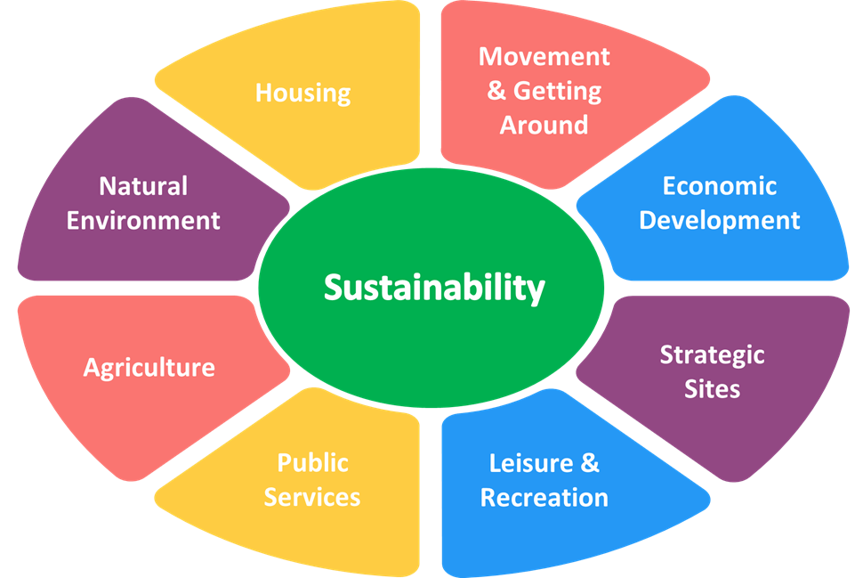
The plan is based on 8 broad themes around the core of sustainability. This thread runs through from central government policy to local policies and is defined as:
“…development that meets the needs of the present without compromising the ability of future generations to meet their own needs”*
Policy Themes
*Thanet District Council’s definition

Slide 11
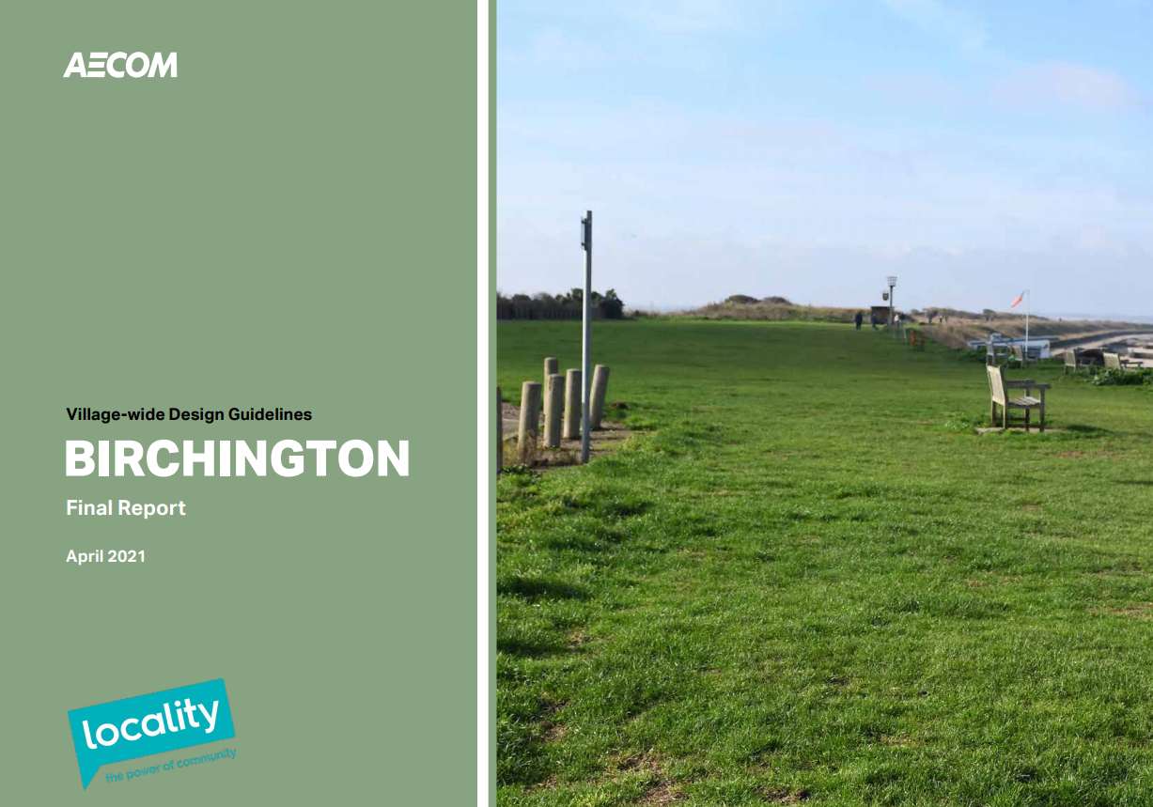
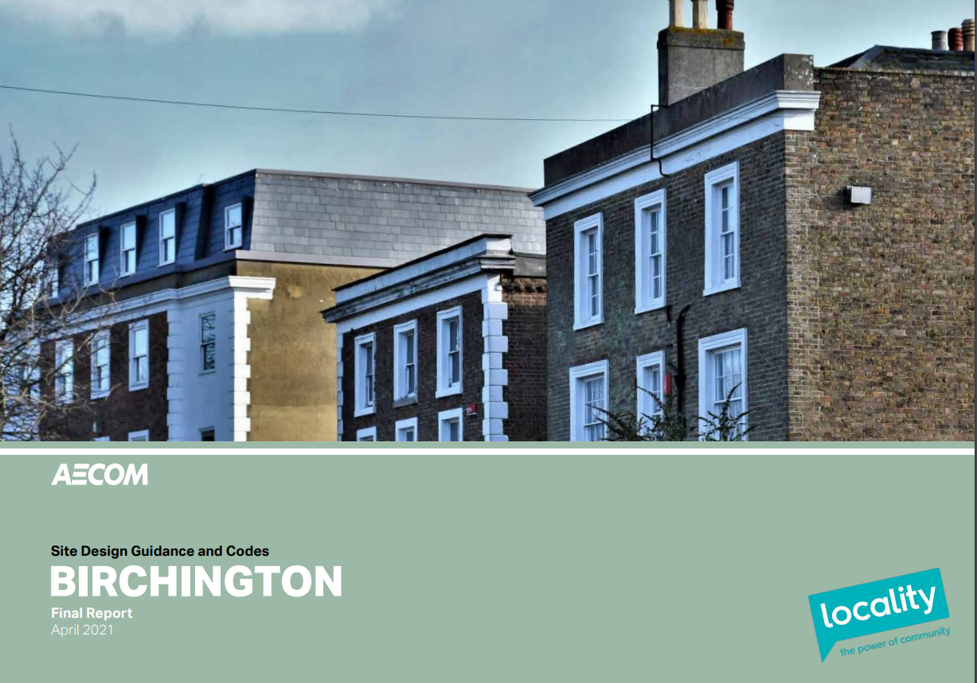
Objective 1: To conserve and enhance the character of our seaside village and its historic environment.
Policy focus:
Design – compliance with local design guides and codes.
Peripheral Development – continuity and seamless transition between existing and new.
Sustainability

Slide 12
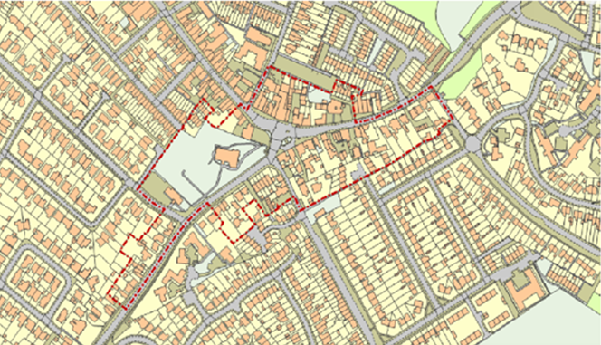
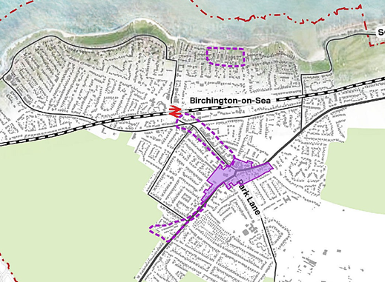
Objective 2: To conserve and enhance heritage assets, the Conservation Area(s), listed buildings and ancient monuments.
Policy focus:
Heritage – protecting and conserving the fabric and setting of local assets.
Sustainability
Existing Conservation Area
Areas of High Townscape Value

Slide 13

Objective 3: To ensure, as far as possible, that new developments are fully sustainable and capable of being built and used creating net zero greenhouse gas emissions.
Policy focus:
Climate Change – net zero greenhouse gases in construction and use.
Sustainability
End our dependency on oil.
Largely eliminate the use of natural gas to heat our homes.
Homes that are efficient and adapted to the future climate.
Clean electricity will become the predominant form of energy.
Is it appropriate to end gas grid connections to new homes being built from 2025?

Slide 14
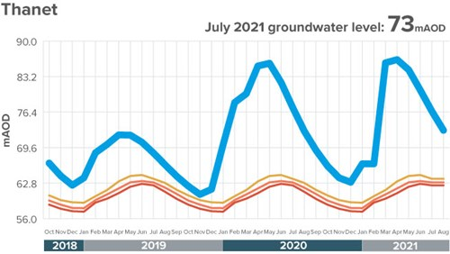
Objective 4: To ensure that utility services, including power, water, sewerage and digital infrastructure can meet the current and future needs of the community.
Policy focus:
Quality & Continuity – providers to submit statements assuring quality, continuity and supply of services
Sustainability
Thanet Ground Water Level – July 2021
Natural gas phased out.
Increasing electric vehicle use.
Potential doubling of electricity demand.
Fast broadband needs.

Slide 15
Objective 5: To secure a fair share of developer contributions to enable timely enhancement and delivery of new community facilities to support population growth caused by development.
Policy focus:
Developer Contributions – a fair share of funding for community schemes.
Sustainability
Examples could be:
Leisure & Recreation
Facilities
Community Halls
Green Spaces & Biodiversity
Trees & Hedgerows
Environmental Improvement
Schemes

Slide 16

A pause for Questions

Slide 17
Objective 6: To protect, conserve and enhance all aspects of the natural environment.
Policy Focus:
Green and Open Space & the Coast
- protection of designated green spaces.
- character and setting of open spaces to be respected.
- countryside and coastal development restricted.
- Green Wedge development limited to sports and agriculture.
Trees, Hedgerows and Landscapes
- retention of trees and hedgerows; net gain replanting where possible.
- protection of ‘landmark trees’.
- local character landscaping.
Natural Environment

Slide 18
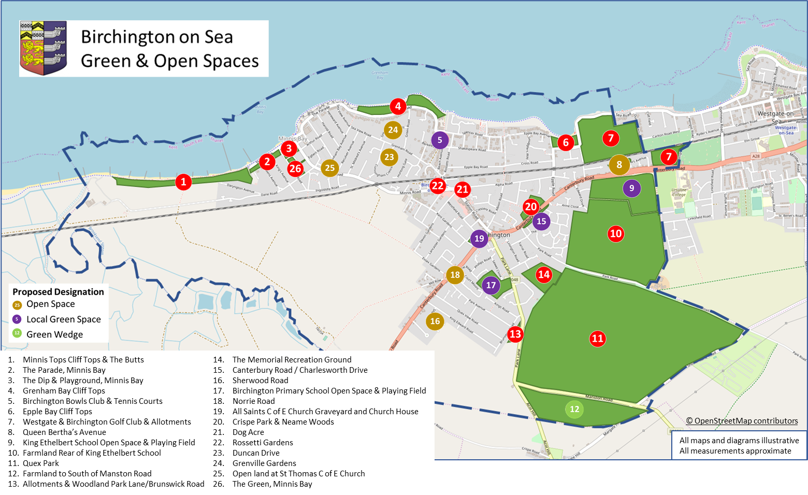

Slide 19

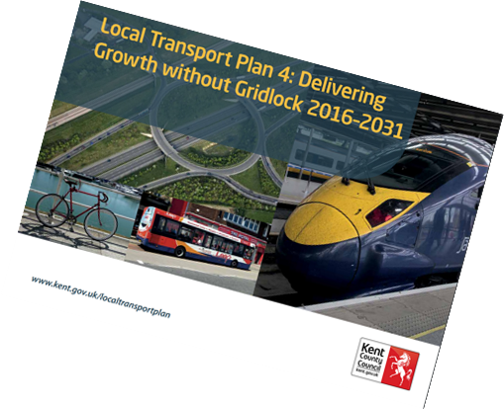
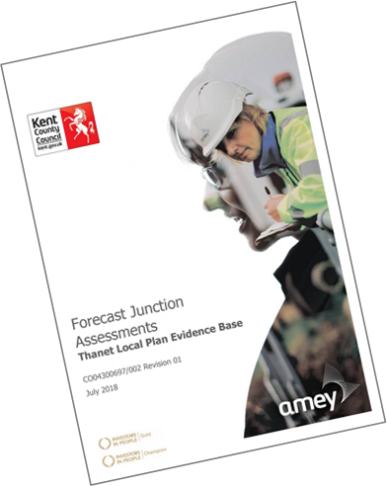
Objective 7: To create safe and healthy pedestrian and vehicular networks which enable free movement for everyone around the village.
Policy focus: Reduction of congestion, improved air quality, development and maintenance of cycle routes and footpaths.
Movement & Getting Around
Road transport causes about 30% of Kent’s greenhouse gas emissions.
The Square: congestion and pollution.
The Inner Circuit: relief road.
New Junctions: Acol Hill, Canterbury Road, Minnis Road.
Protection and development of footpaths, cycle paths and bridleways.

Slide 20
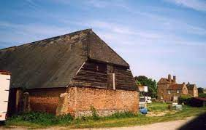
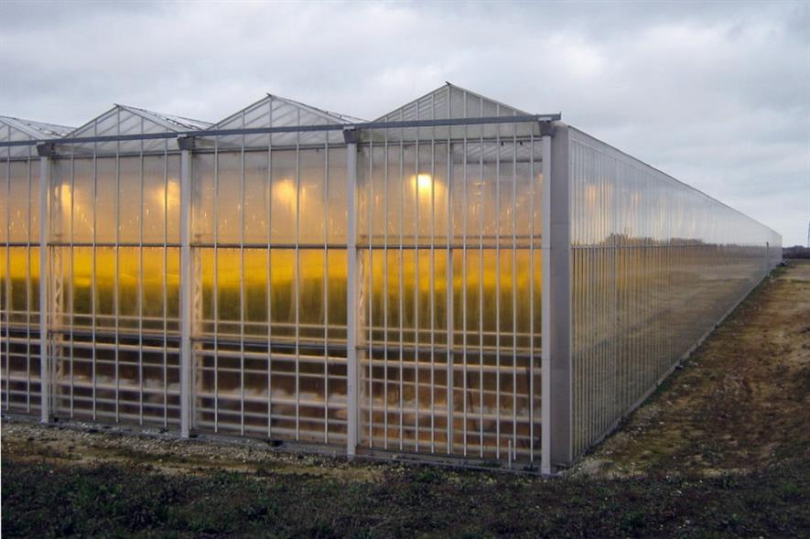
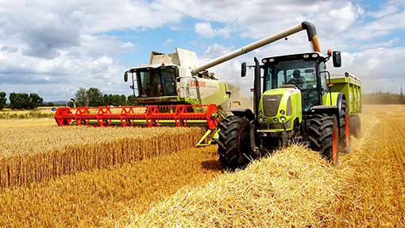
Objective 8: To sustain agricultural production on our best and most versatile farmland and mitigate any losses.
Policy focus: To seek to protect the best farmland and for agricultural development to be in character with surrounding area.
Agriculture
Resist non agricultural development on prime farmland
Brownfield development first
Support appropriate agriculture
Protection from environmental pollution
Maintain local character

Slide 21
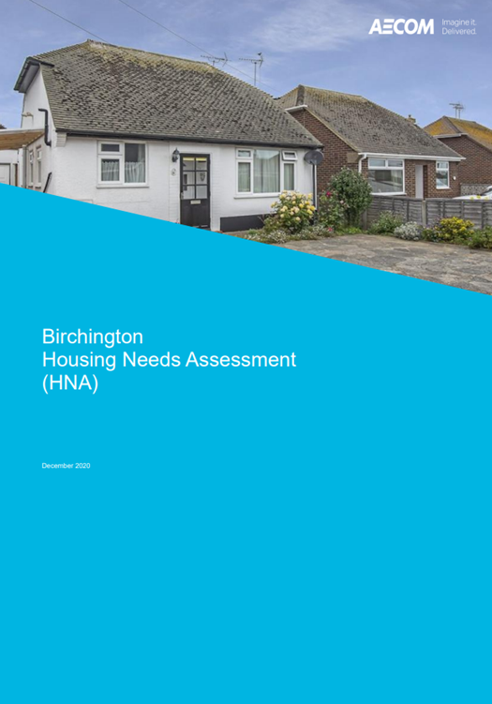
Objective 9: To ensure that there is adequate provision of homes to meet the needs of local people.
Policy focus:
Quantity, Allocation, Tenure and Affordability - Housing to meet local needs and deliver a minimum 30% affordable homes on new developments
Housing
Local Plan allocates 1,600 new homes to Birchington
Housing mix to meet local need
Priority for existing residents
Support 30% Affordable Housing provision
Mixed tenure
Affordable homes to be spread and indistinguishable.

Slide 22
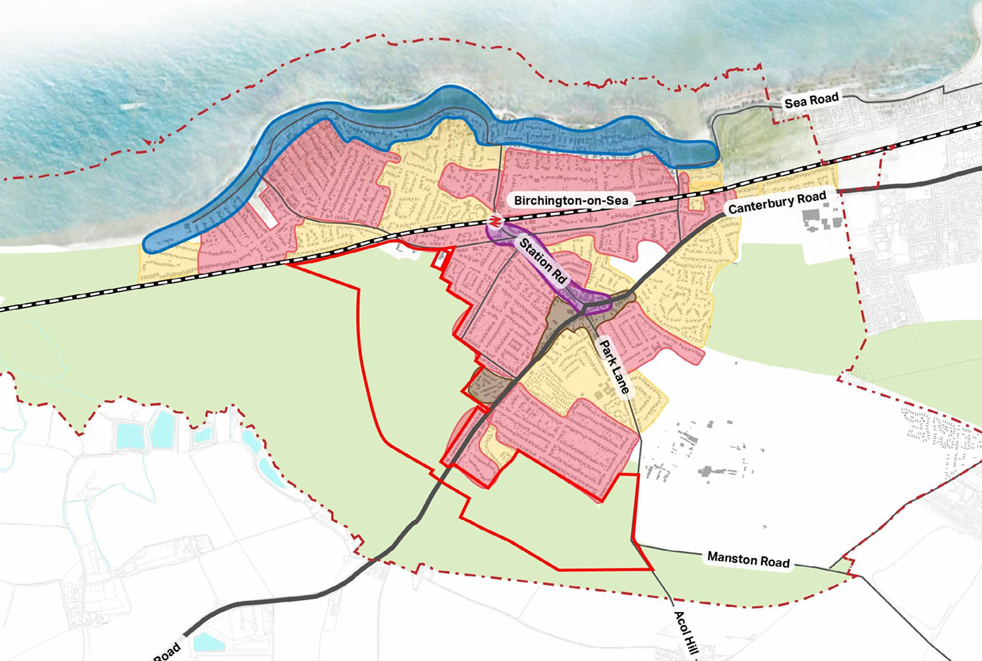
Objective 10: To ensure that adaptations and new housing are built to high quality design standards, respecting the character and building typology of the existing village.
Policy focus:
Quality - New developments and changes to existing buildings should respond positively to the Birchington Village-wide and Site Design Guidelines.
Housing
National building standards
National standards for healthier communities - ‘Building for a Healthy Life’
Locally defined character areas
Quality of Affordable Housing to no less than market housing

Slide 23
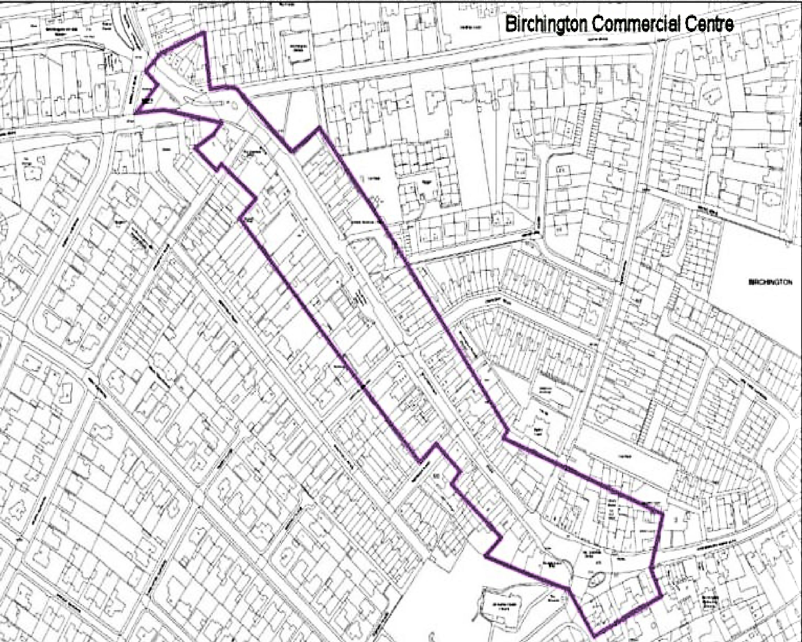
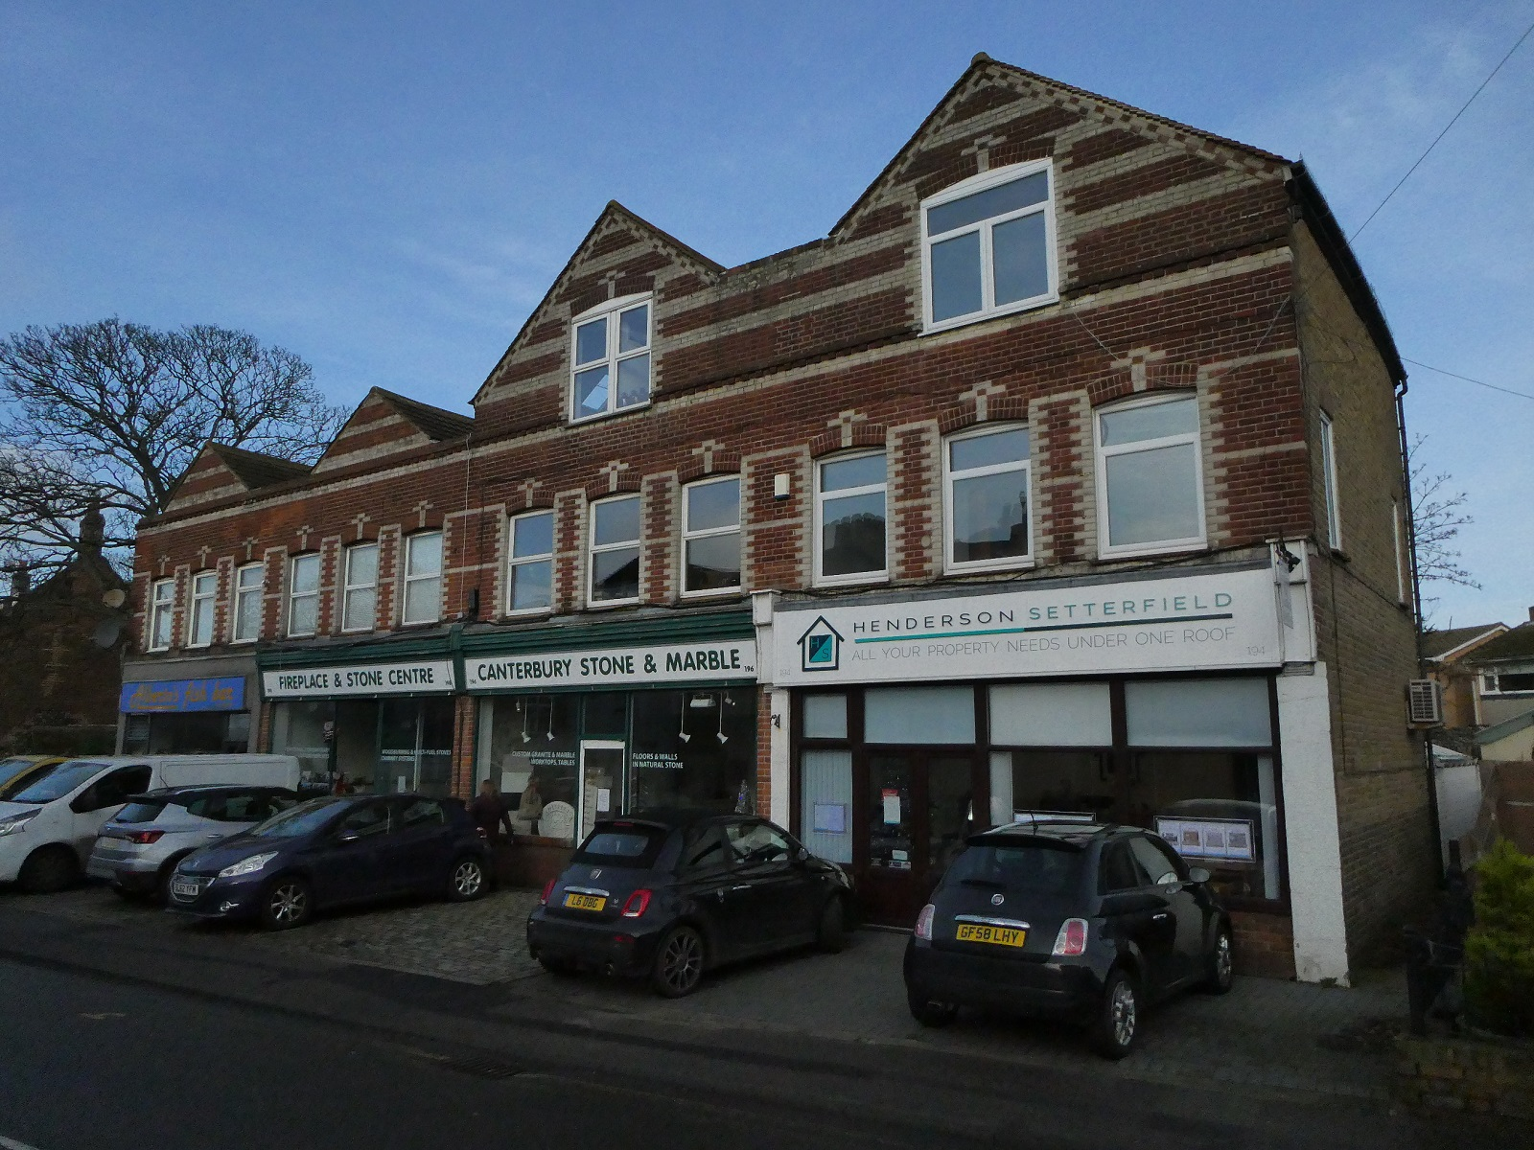
Objective 11: To enable appropriate commercial and business development that is proportionate and contributes to the economy and wellbeing of the village.
Policy focus: Sustaining businesses, supporting development that meets the needs of the community, sensitively managing change and conserving the character of our main retail and business area.
Economy
Station Road & The Square key to village character
Station Road improvement study
Other locations provide vital services for residents and visitors
Support appropriate development that is beneficial to the community

Slide 24
Planning and delivery of health, social care and education services are strategic issues. However, the Plan can influence decision makers as they plan and provide accessible facilities for the community.
Objective 12: Health and Social Care: To support development of facilities that help to sustain, improve and enhance residents’ access to health, social and long-term care facilities.
Health & Education
Policy focus: Support for appropriate facilities that are located to maximise accessibility.
Objective 13: Education: To support development of education facilities that provide equal and accessible opportunities for learning.
Policy focus: Provision of facilities not just for students but available to the community outside operating hours. Playing fields protected from development

Slide 25
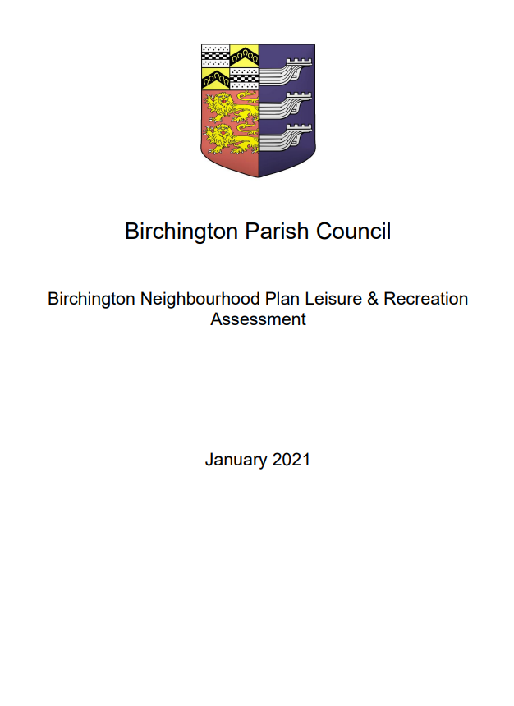
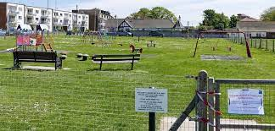
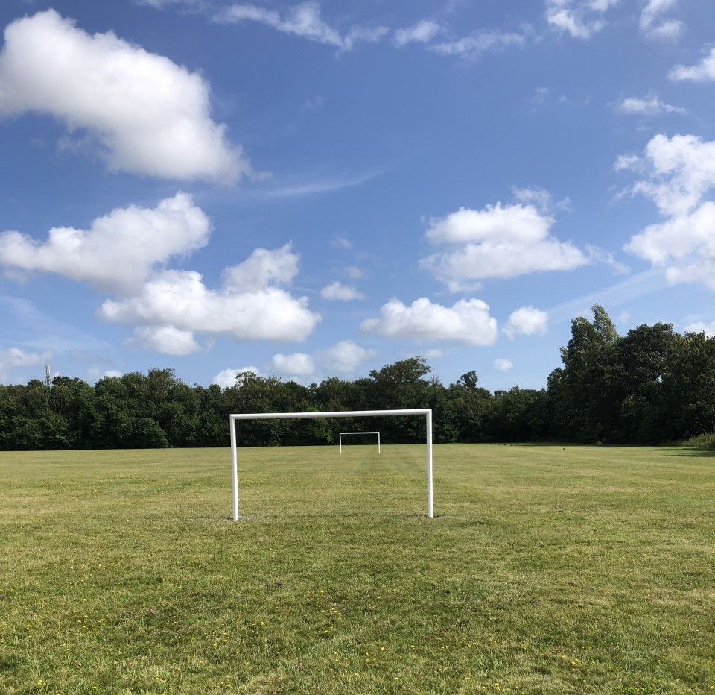
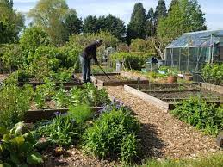
Objective 14: To provide, maintain and enhance high quality indoor and outdoor leisure and recreation facilities that meet the needs of the whole community and support our visitor economy.
Policy focus: To enhance and maintain existing facilities, and to encourage development to reduce the gap between provision and need.
Leisure & Recreation
Shortfall in sports pitches
Memorial Recreation Ground development
Waiting list for allotments
Community halls well used and in need of updating
Support increase and upgrade of facilities
Resist loss or impairment of facilities

Slide 26
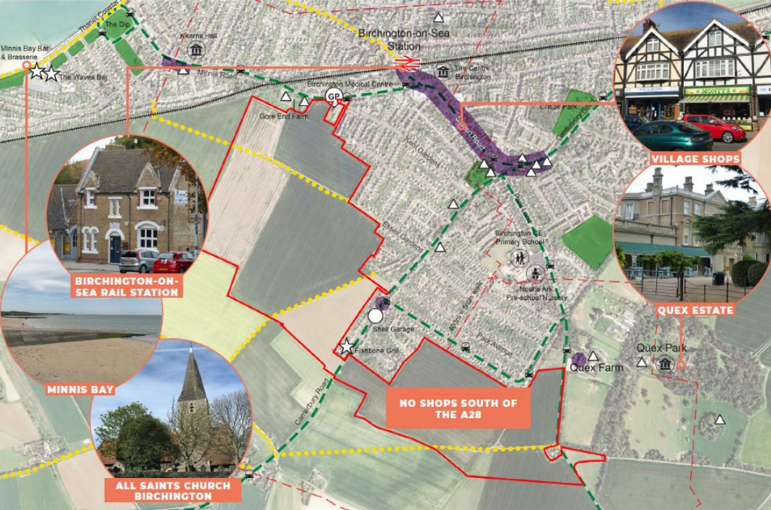
Objective 15: To support development of sites allocated within the Local Plan that is consistent with the community’s wish to “build a village not a housing estate”.
Policy focus: To ensure that new development meets local design codes, reflecting the topography and is consistent with the character of the village. Facilities should meet the needs of the existing community as well as new residents.
Strategic Sites
Design and layout to reflect site topography
Transition between new and existing seamless
Consistency with adjoining character areas
Housing mix
Protect rights of way
Support new pedestrian and cycle routes to connect to the village
New amenities and services to be located in safe, accessible locations

Slide 27

A pause for Questions

Slide 28
September /
October
Formal 42 day Consultation period
Parish Council considers responses, modifies the plan if necessary and approves it
November /
December
Plan submitted to Thanet District Council - TDC publicise and invite comments
What Happens Next?
TDC collate responses, appoint independent examiner and send all documents to him/her
January /
February
Independent Examiner approves, rejects or modifies the Plan
March /
April
If approved (or modified) TDC publicise the Plan and arrange a Referendum
May
> 50% vote in favour
Plan adopted by TDC as part of planning framework: now has legal status

Slide 29
Final reminder:
Consultation begins 8 September for 42 days.
Visit www.birchington-pc.gov.uk for more information
Or Contact us via Email: nhp@birchington-pc.gov.uk
THANK YOU FOR ATTENDING AND CONTRIBUTING THIS EVENING
Closing Remarks

